Slide 1
Accelerating Concurrent Heap on GPUs
Shubham Mittal
2018101
Team-15
Yan-Hao Chen, Fei Hua, C. Huang, Jeremy Bierema, Chi Zhang, and E. Z. Zhang. 2019. Accelerating Concurrent Heap on GPUs. ArXivabs/1906.06504 (2019). https://arxiv.org/abs/1906.06504

Slide 2

Milestones
Mid-Evaluation
Implement Sequential Heap on CPU + Design and Analyse Concurrent Heap Algorithm for GPU in terms of Code implementation
Implement Concurrent Insert-Key Operation on GPU
Final-Evaluation
Implement Concurrent Delete-Key Operation on GPU
Perform Fine Tuning and Optimisations, Stress Test, Performance Evaluation and Measurements

Slide 3
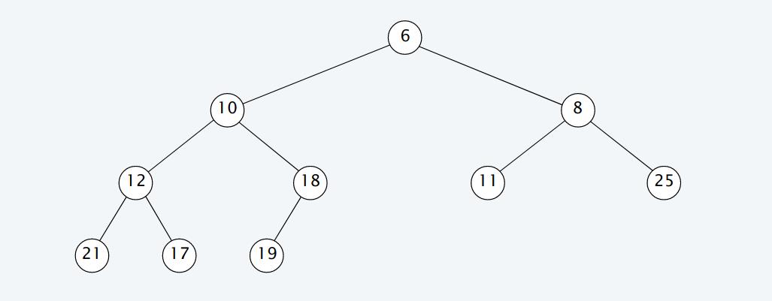
What is Heap?
A tree-like data structure with the following property:
value stored in any node <= value stored in each of its children.

Slide 4
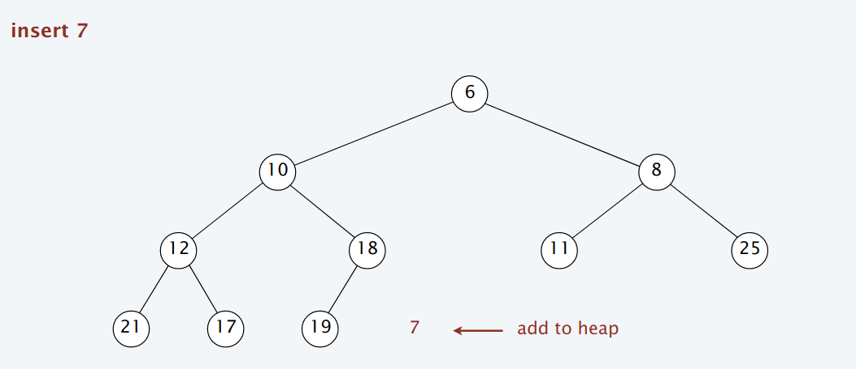
Insertion

Slide 5
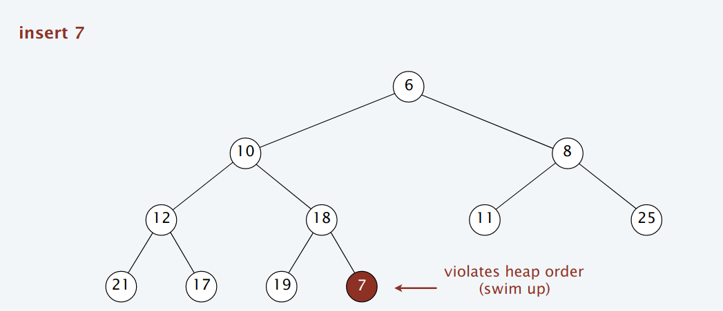
Insertion

Slide 6
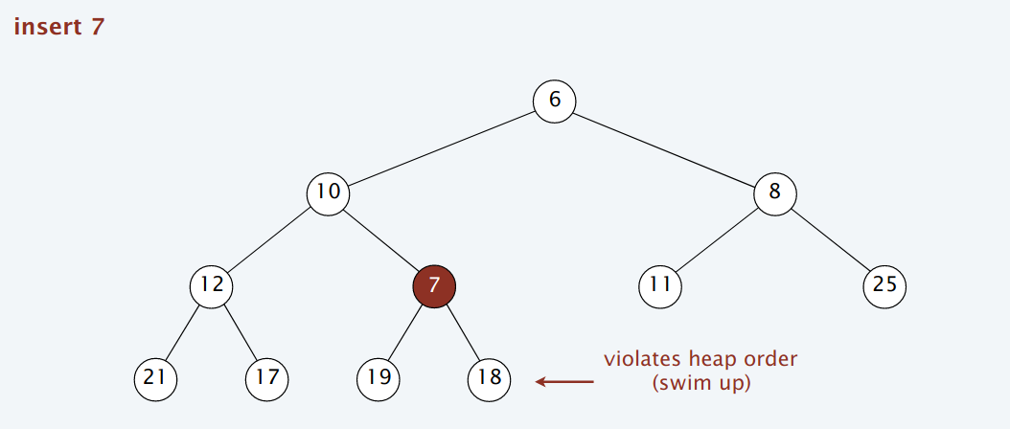
Insertion

Slide 7
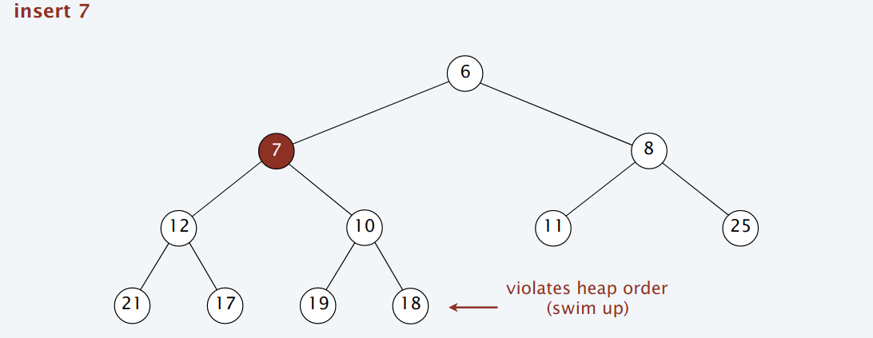
Insertion

Slide 8
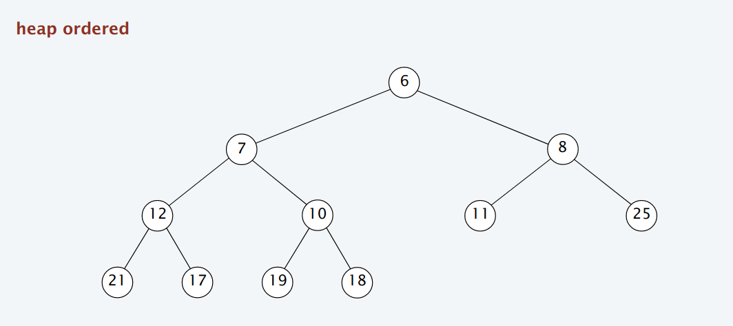
Insertion
O(log n)

Slide 9
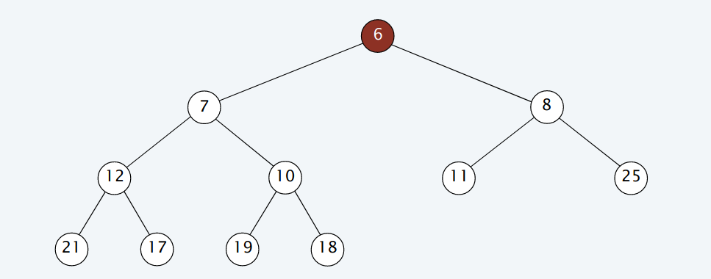
Deletion

Slide 10
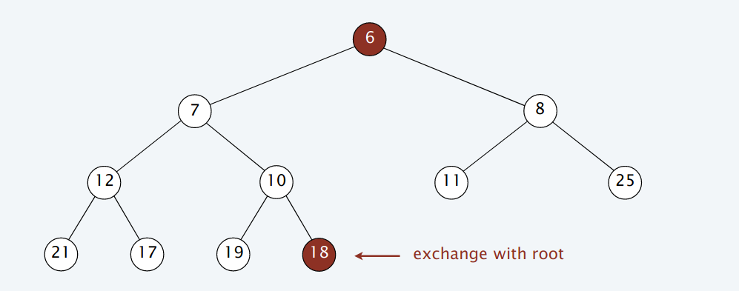
Deletion

Slide 11
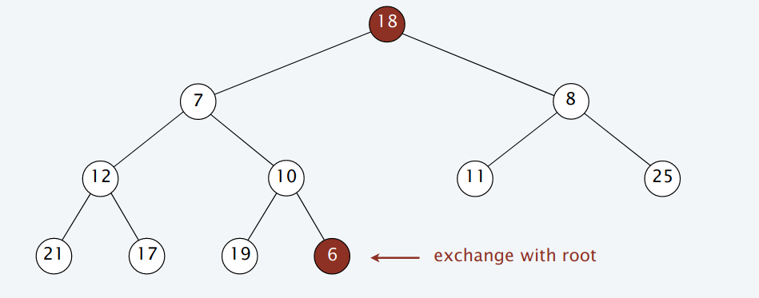
Deletion

Slide 12
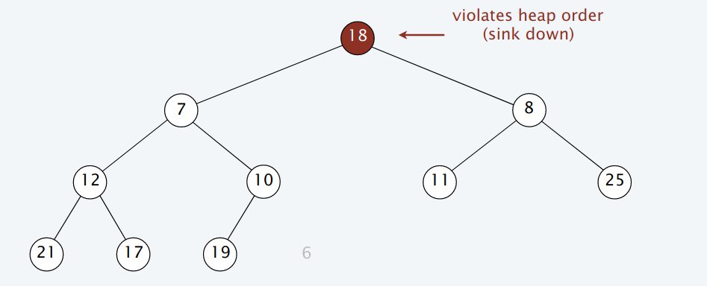
Deletion

Slide 13
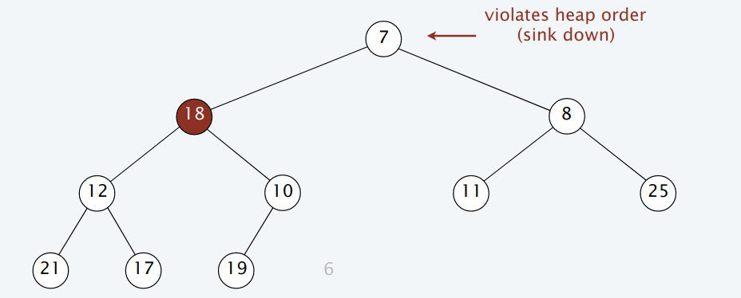
Deletion

Slide 14
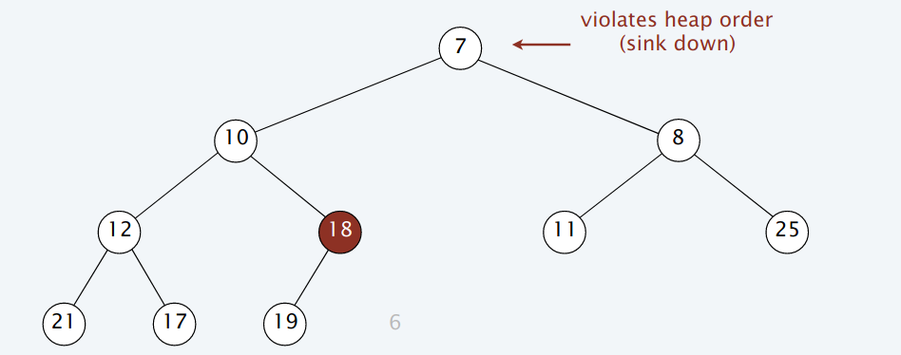
Deletion

Slide 15
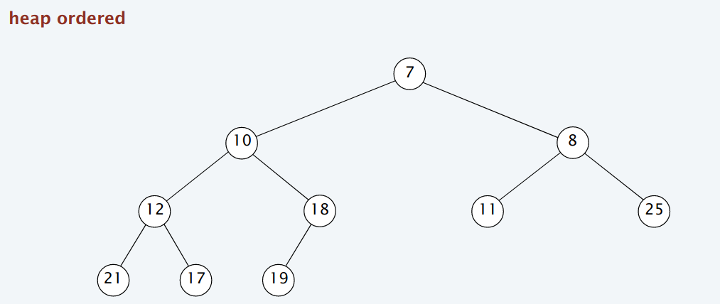
Deletion
O(log n)

Slide 16
But, is this approach scalable over GPU?
No.
Control Divergence
Memory coalescing

Slide 17
Let’s try to make some changes in our “conventional” heap so that we can achieve minimum control divergence and maximum memory coalescing.

Slide 18
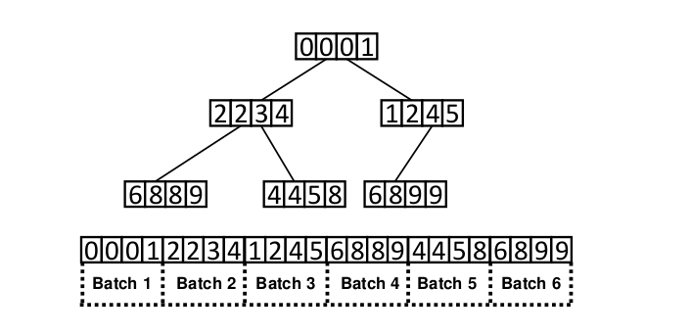
Generalised heap
Each node has more than one values in it.
Properties:
Each batch should be sorted within itself.
Smallest key in any batch ≥ largest key in its parent batch except root node since it has no parent.
A batch, with batch size = 4.

Slide 19
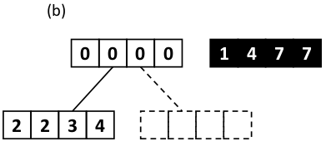
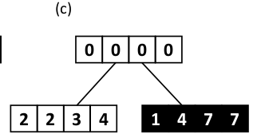
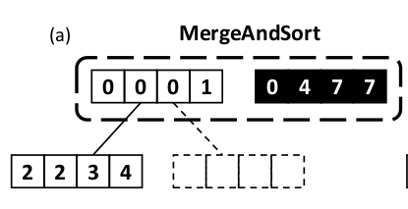
Insertion
Let’s we have to insert insertKeys in our heap.
First sort insertKeys using Bitonic Sort
Propagate from the root node to the target node while merging with the nodes present in path from root to target using MergeAndSort such that it always satisfies the root properties.

Slide 20
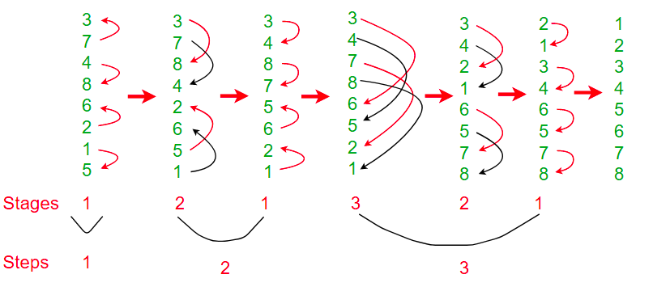
Bitonic Sort
O(nlog² n / P)
Further Info

Slide 21
MergeAndSort
O(n + m), not parallelizable
Animation ref

Slide 22
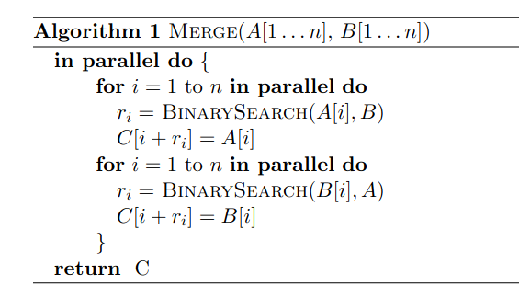
MergeAndSort
O( (n+m) * log max(n,m) )
Parallelizable...
Though this has warp divergence a lot, but I ran both the algorithms and this performed much better than O(n + m).
Reference

Slide 23
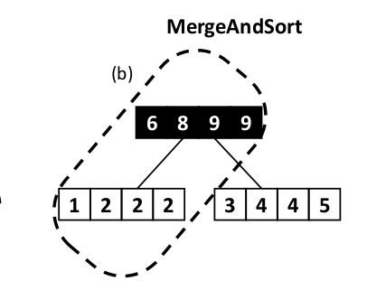
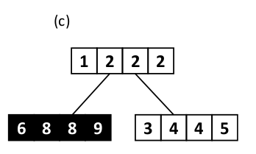
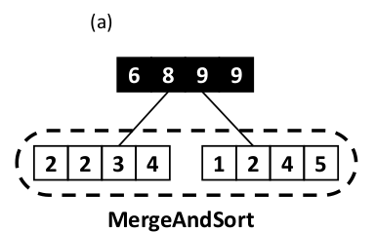
Deletion
We will delete exactly k(=batch size) nodes from the root of the heap and copy the last node into the root node and perform the heapify operation on root node until we satisfy all the generalised-heap properties.
Merge both child
Merge left child and parent

Slide 24
How to bring concurrency in both operations?
Locks on each node
Ensure lock ordering to prevent deadlock.
Ensure kernel invoked first should take the lock first on root node to ensure correctness.
Lots of atomic operations, __syncthreads() and __threadfence().

Slide 25
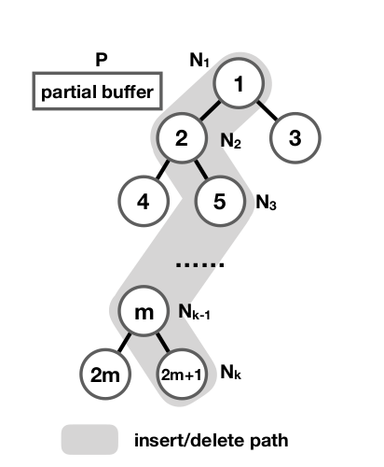
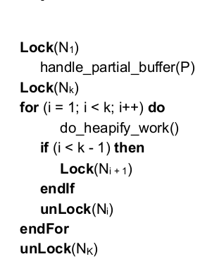
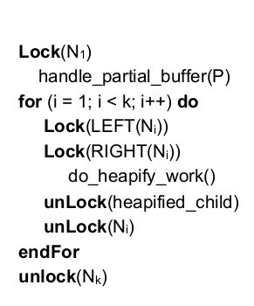
Concurrent Insertion and Deletion
Insertion Deletion

Slide 26
Optimisations
Early Stopping of operations
Bit Reversal to reduce lock contention between two consecutive operations
Special cases in MergeAndSort when already sorted
Bit-reversal: 9₁₀ = 1001₂ = 1100₂ = 12₁₀

Slide 27
Benchmark: Heap Sort
Compared with CPU Sequential code written by me
Compared with Heap in STL

Slide 28
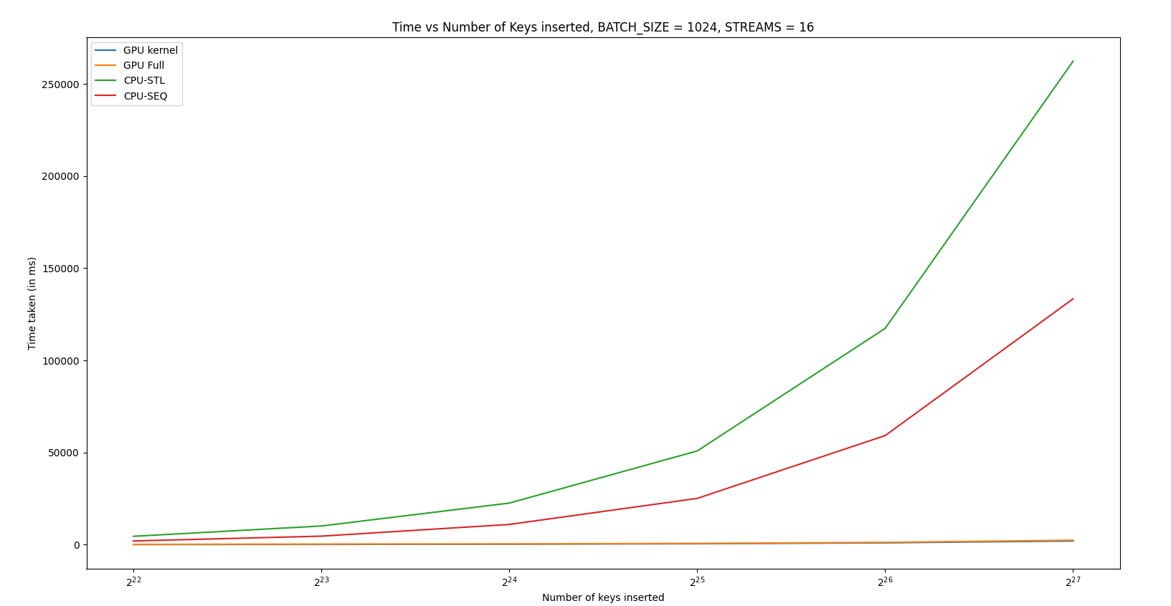
Time vs Number of keys Inserted
First all keys randomly generated were inserted and then all keys were deleted.
Number of CudaStreams were fixed = 16 and Batch Size = 1024
Log scale base 2

Slide 29
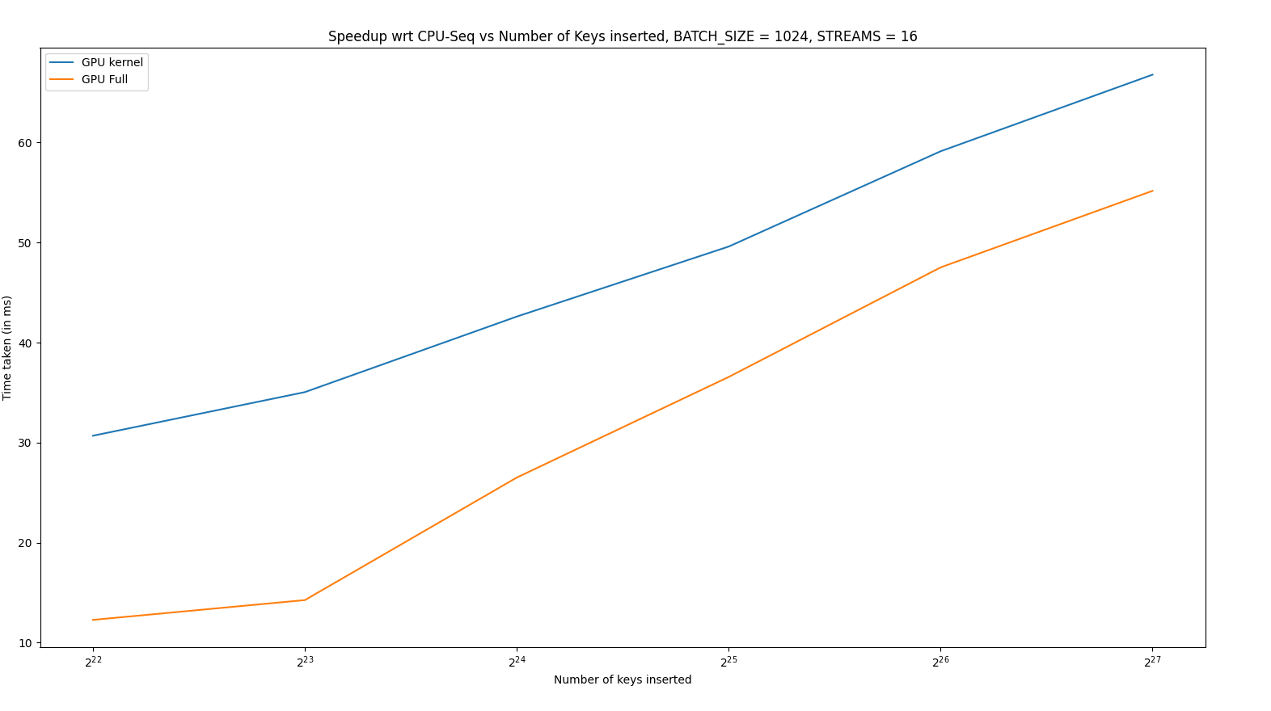
Speedup vs Number of keys Inserted
Speedup = ~66
and ~55 respectively
~134 million keys

Slide 30
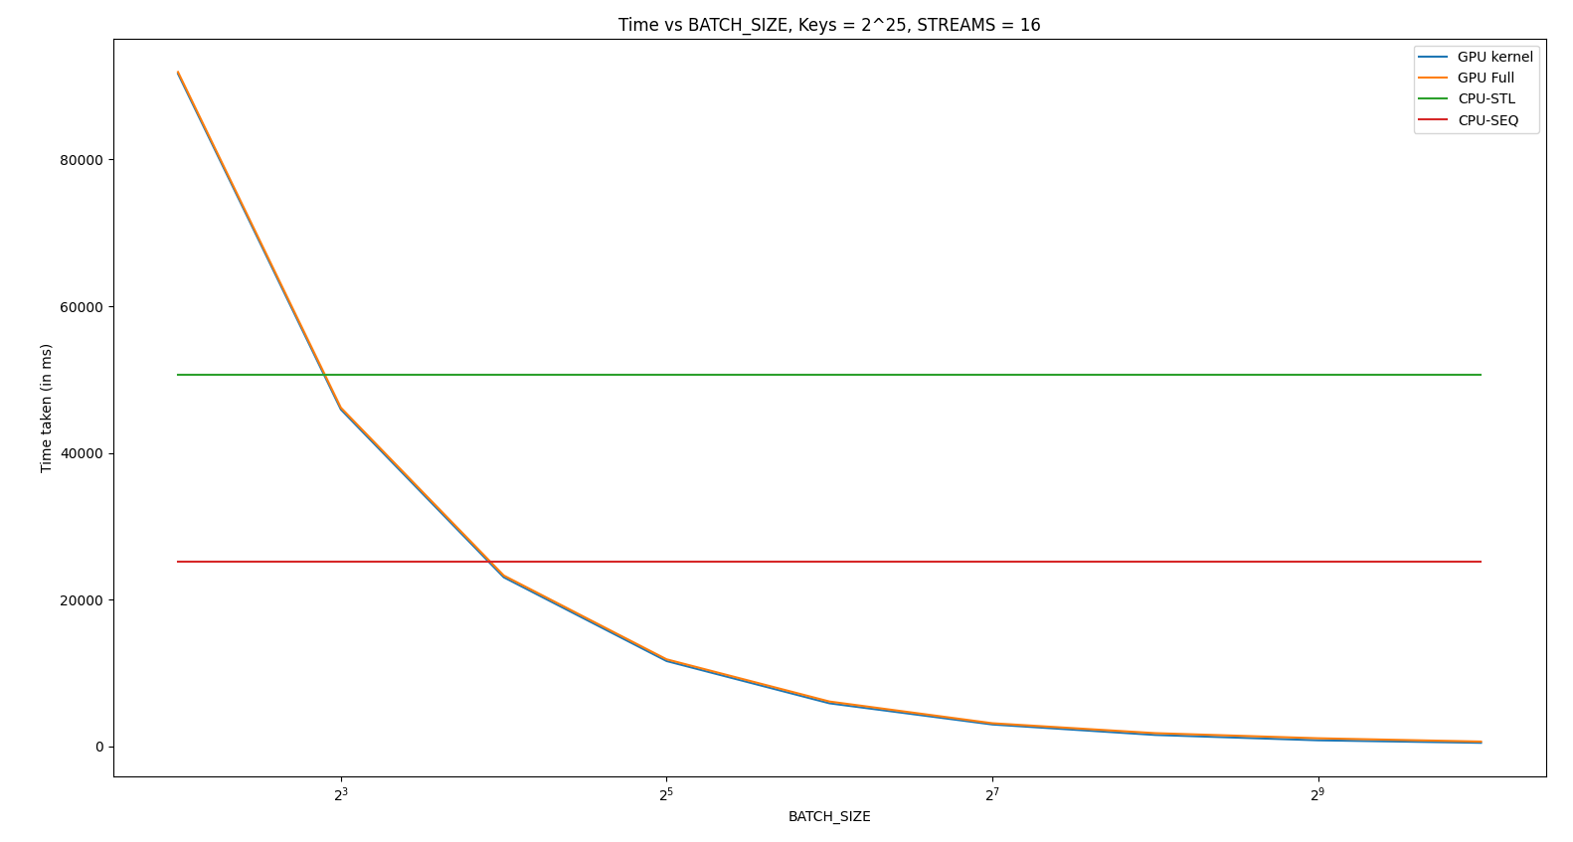
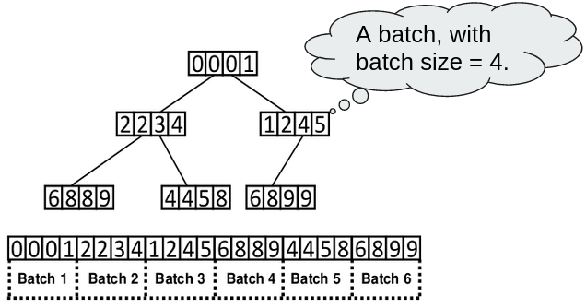
Time vs Batch Size
First all keys randomly generated were inserted and then all keys were deleted.
Number of Keys were fixed = 2²⁵ = ~ 3e7 and Cuda Streams = 16
Log scale base 2

Slide 31
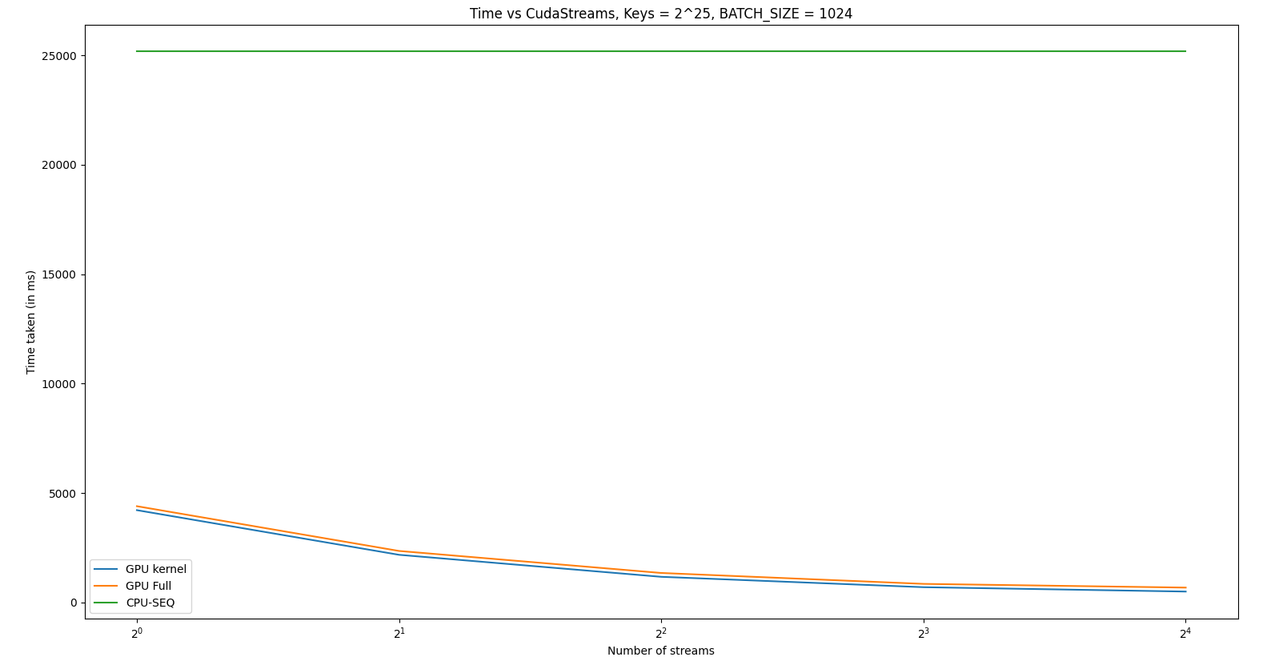
Time vs CudaStreams
First all keys randomly generated were inserted and then all keys were deleted.
Number of Keys were fixed = 2²⁵ = ~ 3e7 and Batch Size = 1024
Log scale base 2

Slide 32
Nvidia Visualiser Profiler

Slide 33
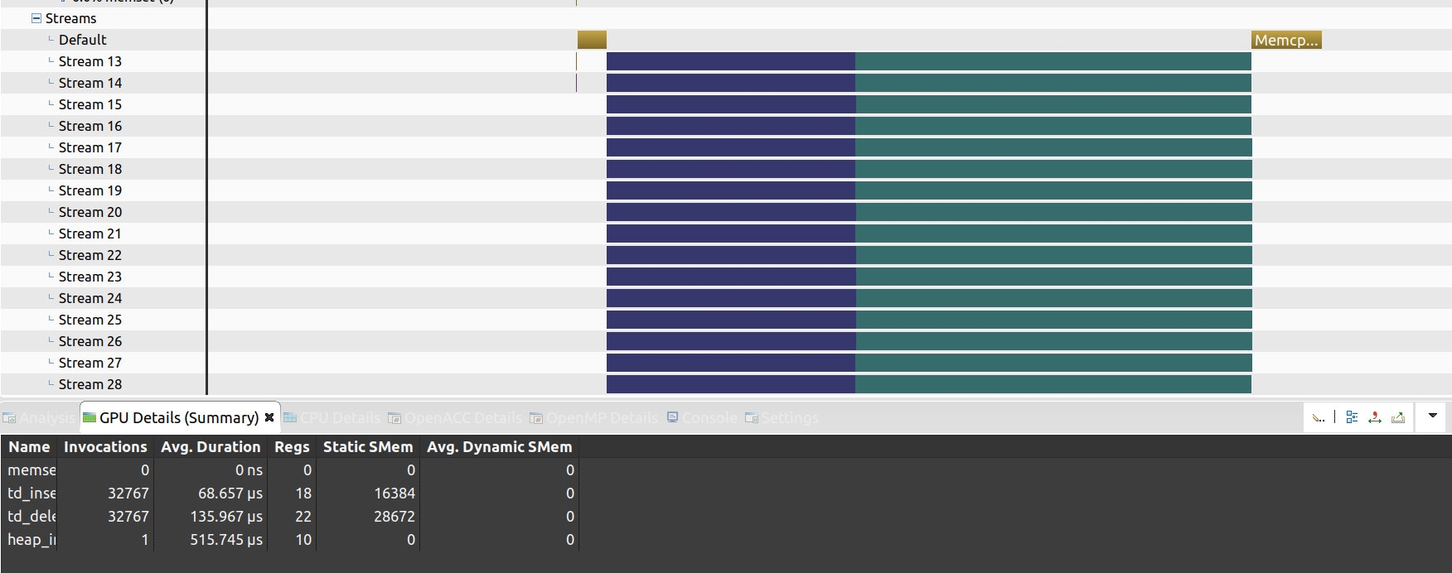
Blue: insertion
Green: delete
Streams = 16 Batch Size = 1024 # keys = 2²⁵

Slide 34
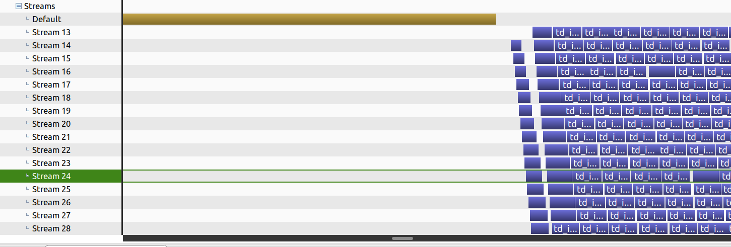
Blue: insertion
Green: delete
Streams = 16 Batch Size = 1024 # keys = 2²⁵

Slide 35
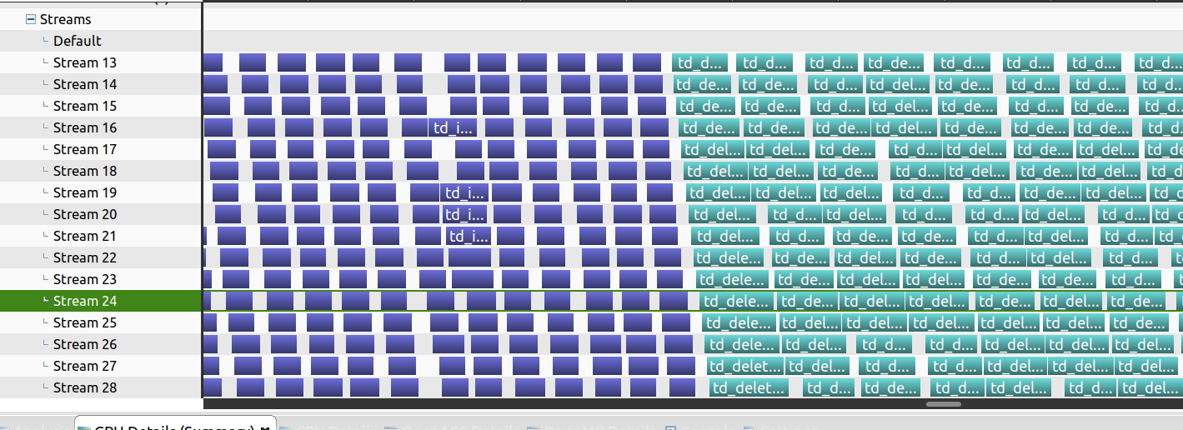
Blue: insertion
Green: delete
Streams = 16 Batch Size = 1024 # keys = 2²⁵

